Slide 1
Sustainability of small to medium sized arts and cultural organisations in Queensland
Arts Queensland
April 2019

Slide 2
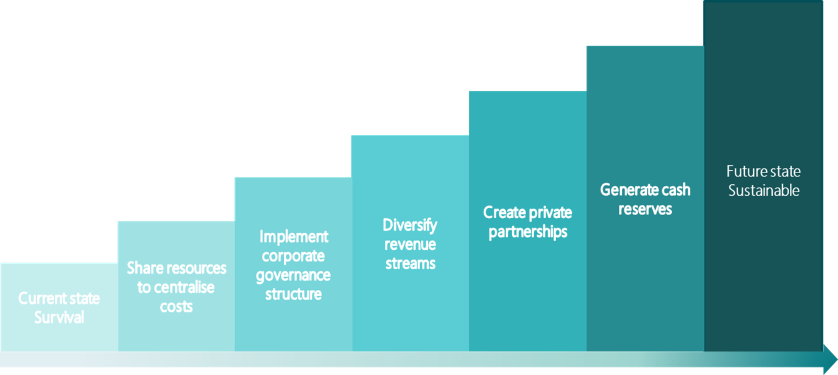
Purpose of the report
Purpose
The purpose of our report was to identify the key challenges and opportunities facing organisations when delivering on their strategic and operational plans. The report prepared for AQ provided insight into our sample size including 10 organisations; five government core funded and five non-funded organisations.
Summary of assessments
In order to complete this, we have performed a business health check to assess sustainability within the small to medium sized Queensland arts and cultural sector.
The business health check was completed using survey data and conducting structured interviews with each of the selected organisations.

Slide 3
Sustainability assessment
01
04
Financial
Level of reserves
Revenue streams
Reporting and knowledge
Assets vs liabilities
Grant management
Resources
Quality of premises
Training
Location
Shared expertise
Technology
02
05
Employment
Work life balance
Resource
Time
Skills
Grant management
Connectivity
Networks
Champions
Interaction with AQ
Partnerships
Seats on tables
Alliances
03
06
Governance
Board Structure
Skills
Time/meetings
Vision/strategy/aspiration
Alignment with AQ
Business acumen
Know how
Time to work on business
Information and data
Understanding of ROI

Slide 4
Key findings
Access to premises and desired locations
Shortage of skills and talent
Clarity of funding objectives
Limited operating and capacity resources
Lack of reserves and weak balance sheets
Key artistic personnel undertaking several active roles

Slide 5
Best value incentives
Provide best practice sustainability models (hybrid)
Increase connectivity
Sharing of resources and centralising costs
Potential restructure of funding allotments and clarifying objectives
Support for jobs

Slide 6
HIGH RISK CONFIDENTIAL
CONFIDENTIAL
PUBLIC

